Slide 1
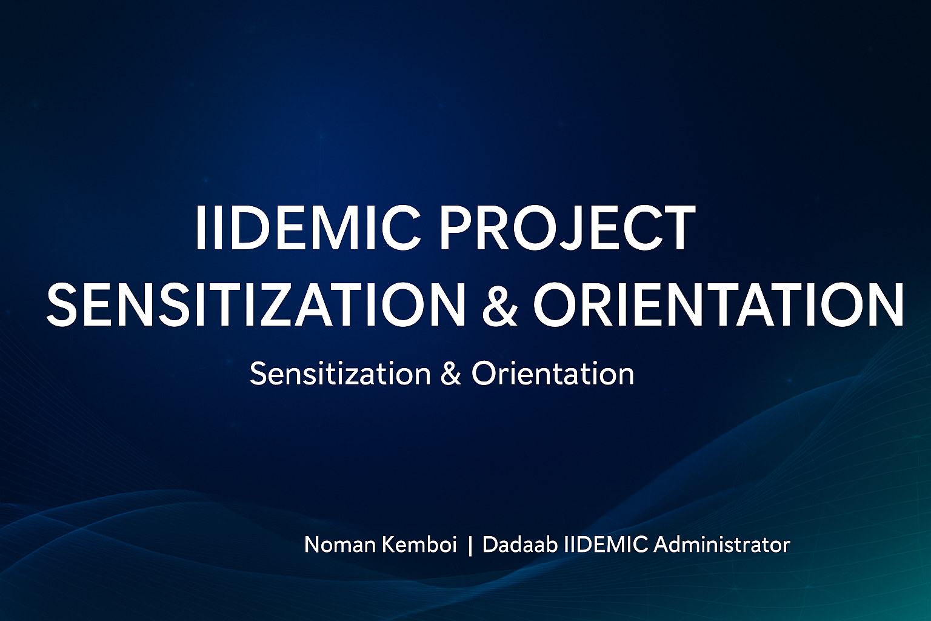

Slide 2

Empowering Teachers in Migrant Communities

Slide 3
Context of Migrant Education
Dadaab Overview:
A sprawling refugee complex established in 1991.
Currently shelters nearly 500,000 refugees, mainly from Somalia, Ethiopia, South Sudan, and the DRC.
Situated in an ASAL (Arid and Semi-Arid Land) region with harsh climatic and economic conditions.
Community Profile:
Diverse demographic: children, youth, elderly, and persons with disabilities.
High population of school-aged children with limited access to consistent quality education.
Education as a Lifeline:
Restores hope and dignity.
Builds skills, fosters resilience, and opens opportunities for the future.

Slide 4
Engagement Prompt
To the stakeholders present: "What would you do if you had to teach in a classroom with over 100 students from different cultures, speaking multiple languages?“
Teachers present: How do you do it?!

Slide 5
Challenges Faced by Teachers/Workers
Overcrowded Classrooms:
80–120 students per class.
Few resources—1 textbook shared by 5–7 students.
Inadequate classroom space and furniture.
Infrastructure Gaps:
Inaccessible buildings for students with disabilities.
Limited water, sanitation, and hygiene (WASH) facilities.
Staffing Shortages:
Acute need for IRE, CRE, Kiswahili, and SNE teachers.
High teacher burnout and attrition due to work conditions.

Slide 6
Challenges Faced by Teachers/Workers
Inclusion Barriers:
Lack of Braille and assistive tech.
Limited teacher training in inclusive pedagogy.
Technology Gaps:
Low digital literacy among both learners and teachers.
Inadequate devices and unreliable internet.
A teacher told me, “Sometimes I feel helpless when I can’t provide individual attention to all my students.”

Slide 7
Introduction to IIDEMIC Project
IIDEMIC (Inclusive Innovation for Digital Education and Migrant Integration Communities) is a pilot project.
Goal: Enhance education delivery and inclusion in migrant settings like Dadaab.
Led by: Kenyatta University
In collaboration with: Windle International Kenya, local education stakeholders, and Dadaab-based partners.

Slide 8
Project Objectives
Improve digital access and inclusion for teachers and learners.
Promote inclusive and disability-friendly teaching practices.
Build soft skills and 21st-century competencies among youth and educators.
Establish data and resource centers with assistive technologies.

Slide 9
Key Components of IIDEMIC
Soft Skills & Employability
Inclusive Pedagogy & UDL
Digital Integration
Innovation Hubs
Empowering Refugee Teachers

Slide 10
Key Components of IIDEMIC
1. Soft Skills & Employability:
Modules in problem-solving, creativity, communication, collaboration.
Enhancing job-readiness and adaptability among learners.
2. Inclusive Pedagogy:
Training teachers to handle learners with special needs.
Using UDL (Universal Design for Learning) principles.
Mainstreaming gender and disability inclusion.
3. Digital Integration:
Interactive content delivery.
Use of tablets, laptops, and internet-enabled tools.
Building teacher capacity for blended learning.

Slide 11
Key Components of IIDEMIC
4. Establishing Resource & Data Centers.
Accessible information in Braille/audio/visual formats.
Promoting locally driven innovations from refugee and host youth.
5. Empowering Refugee Teachers:
Recognition and professional growth.
Peer-to-peer learning.
Leadership and mentorship roles.

Slide 12
Target Beneficiaries
Initial phase: 40 high school teachers (pilot).
Scale-up phase: Additional 150 teachers across the Dadaab refugee complex.
Focus on inclusivity, technology, and innovation adoption.

Slide 13
Expected Impact
Teachers equipped with inclusive pedagogical and digital skills.
Enhanced learner engagement, especially for children with disabilities.
Improved career pathways through competency-based training.

Slide 14
Key Note
IIDEMIC is not just another project. It is a transformative movement for inclusive education, technology-driven innovation, and dignified empowerment for communities that need it most. Your role as a stakeholder, educator, or partner will be instrumental in shaping this journey. Let us walk together to create a future where education is not a privilege but a right accessible to all—regardless of their circumstances.

Slide 15
Stakeholder Role & Participation
Support data sharing on target teacher populations.
Mobilize teachers for engagement sessions.
Facilitate joint planning and coordination for implementation.
Contribute insights during orientation and capacity-building workshops.

Slide 16
Next Steps
Launch
Launch training and mentoring activities.
Track
Track progress, collect feedback, and scale.

Slide 17
Closing Remarks
IIDEMIC is a transformative education movement
Call to action for stakeholders and educators
Thank you and invitation for reflections and questions

